Slide 1
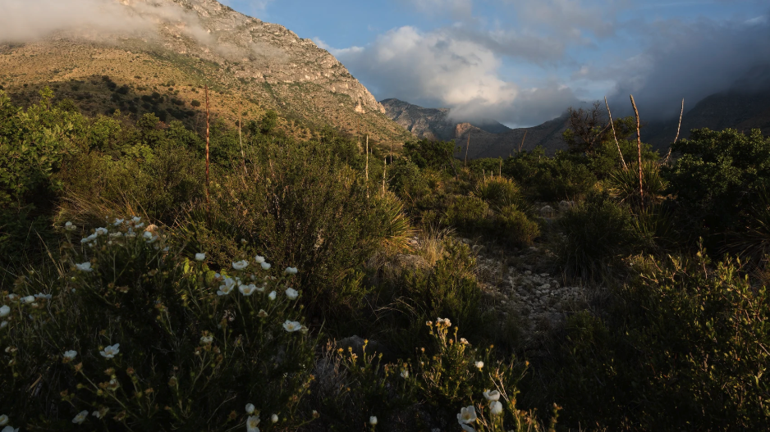
Using eco-evolutionary optimality principles to understand and predict photosynthetic acclimation
Nick Smith
Texas Tech University
nick.smith@ttu.edu

Slide 2
Photosynthesis is a key component of the global carbon cycle
Data from IPCC (2013)

Slide 3
Photosynthesis is a key component of the global carbon cycle
Photosynthesis
Data from IPCC (2013)

Slide 4
Photosynthesis is a key component of the global carbon cycle
Photosynthesis
A small percentage change in photosynthesis can have large consequences for climate
Data from IPCC (2013)

Slide 5
But predictions are uncertain!
Friedlingstein et al. (2014) J Climate

Slide 6
But predictions are uncertain!
Future model uncertainty (14 Pg) > current fossil fuel emissions (9.5 Pg)
Friedlingstein et al. (2014) J Climate

Slide 7
This uncertainty is driven by uncertainty in photosynthesis
Friedlingstein et al. (2014) J Climate
Keenan et al. (2023) Nature Climate Change

Slide 8
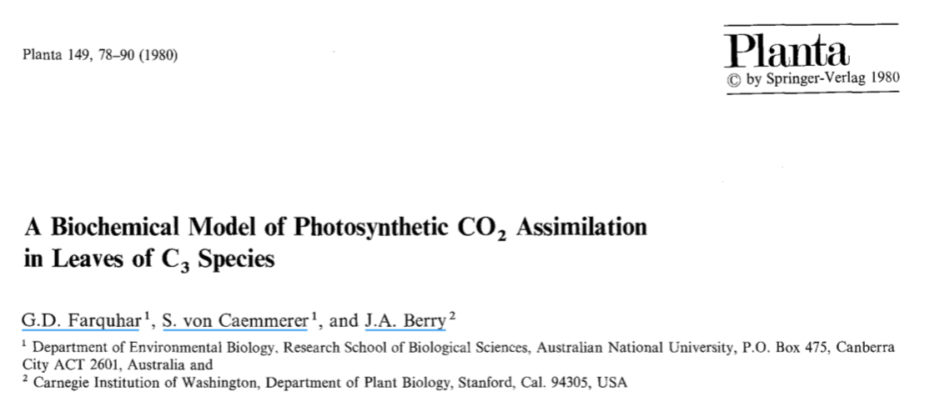
Why the uncertainty? Theoretical models for photosynthesis exist

Slide 9
These produce short term responses that match data

Slide 10
Why the uncertainty? Long-term responses differ from short-term responses due to acclimation

Slide 11
Dumb plants

Slide 12
Acclimation: an example
Acclimated to high light
Acclimated to low light

Slide 13
Acclimation: an example
Acclimated to high light
Acclimated to low light
Photosynthesis peaks a light level close to the level the leaf is acclimated to

Slide 14
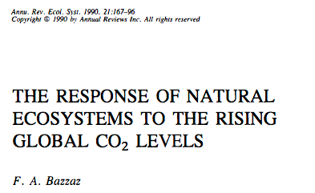
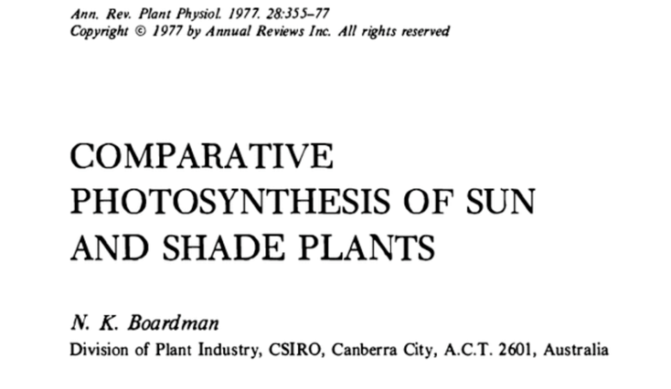
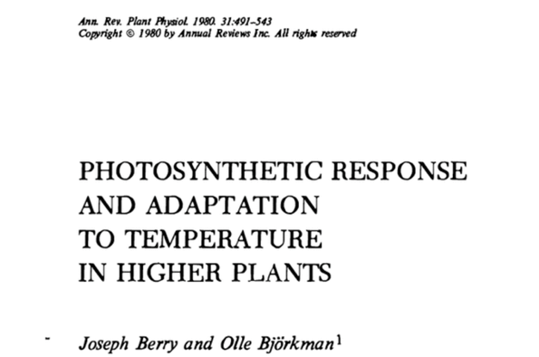
Acclimation is ubiquitous and well known…
Temperature: Berry & Björkman (1980)
CO₂: Bazzaz (1990)
Light: Boardman (1977)

Slide 15
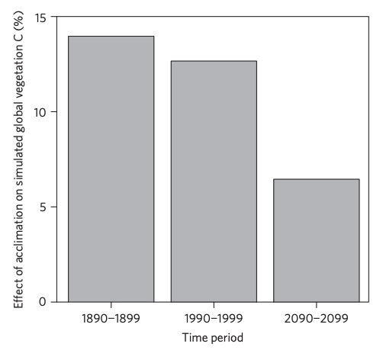
…and can impact carbon cycling and climate
Acclimation increase future C storage by ~6%
Acclimation alters future temperature by >1°C
Smith et al. (2017) Nature Climate Change
Smith et al. (2017) JAMES

Slide 16
Unfortunately, no theoretical model for photosynthetic acclimation exists

Slide 17
Lack of theory results in…

Slide 18
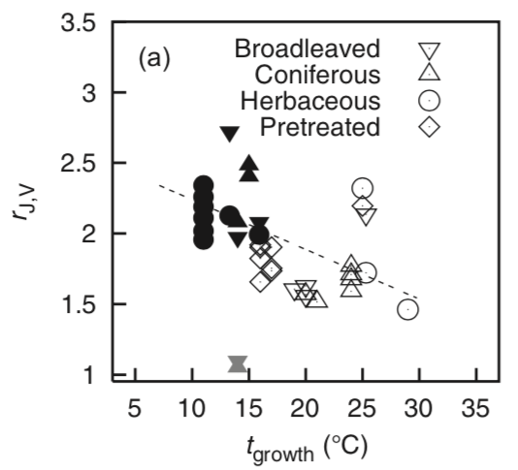
Lack of theory results in…
Unreliable future predictions (overparameterization, tuning)
Reliance on statistical models
Resulting change in simulated photosynthesis
Physiological parameter
Environmental condition
Kattge and Knorr (2007) PC&E
Smith et al. (2017) JAMES

Slide 19
Lack of theory results in…
Inability to test mechanisms
Resulting change in simulated photosynthesis
Physiological parameter
Environmental condition
Kattge and Knorr (2007) PC&E
Smith et al. (2017) JAMES

Slide 20
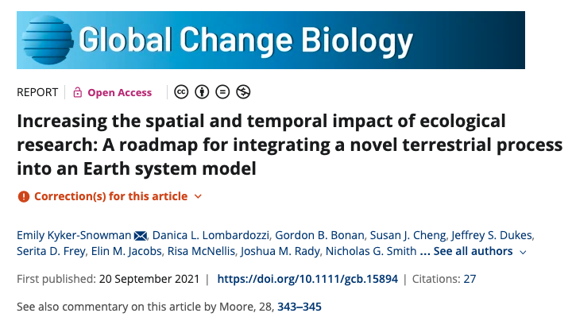
Lack of theory results in…
Inability to test mechanisms
Resulting change in simulated photosynthesis
Physiological parameter
Environmental condition
Kyker-Snowman et al. (2022) Glob Change Biol

Slide 21
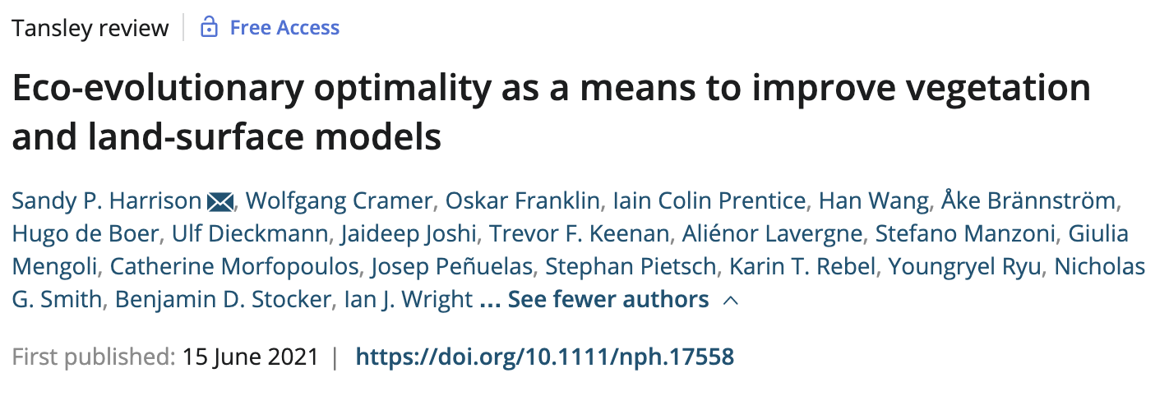
So, we developed a mechanistic model of photosynthetic acclimation Based on optimization and the first principles of plant physiological theory
Harrison et al. (2021) New Phyt

Slide 22
Optimization: Least cost theory
Optimally, plants will maintain fastest rate of photosynthesis at the lowest summed resource cost (water and nutrient use)
Wright et al. (2003) Am Naturalist

Slide 23
Optimal photosynthesis
Photosynthesis = f{stomatal conductance,
photosynthetic biochemistry}

Slide 24
Optimal photosynthesis
Photosynthesis = f{stomatal conductance,
photosynthetic biochemistry}
Must predict optimal rates of both

Slide 25
Optimal photosynthesis
Photosynthesis = f{stomatal conductance,
photosynthetic biochemistry}
[TALK TO ME LATER ABOUT THIS IF YOU ARE INTERESTED]
Prentice et al. (2014) Ecol Letters; Wang et al. (2017) Nature Plants; Smith et al. (2019) Ecol Letters; Smith and Keenan (2020) Glob Change Biol

Slide 26
Optimal photosynthesis
Photosynthesis = f{stomatal conductance,
photosynthetic biochemistry}

Slide 27
Biochemistry optimization
Plant biochemistry setup will aim for equal limitation by all factors
[TALK TO ME LATER ABOUT THE MATHS]

Slide 28
Optimally: electron transport-limited (A_{j}) = Rubisco-limited (A_{c})
A_{j} = A_{c}
A_{j} = f{light, T, CO₂}
A_{c} = f{V_{cmax}, T, CO₂}
Smith et al. (2019) Ecol Letters

Slide 29
V_{cmax} = f {light, T, CO₂}
Smith et al. (2019) Ecol Letters

Slide 30
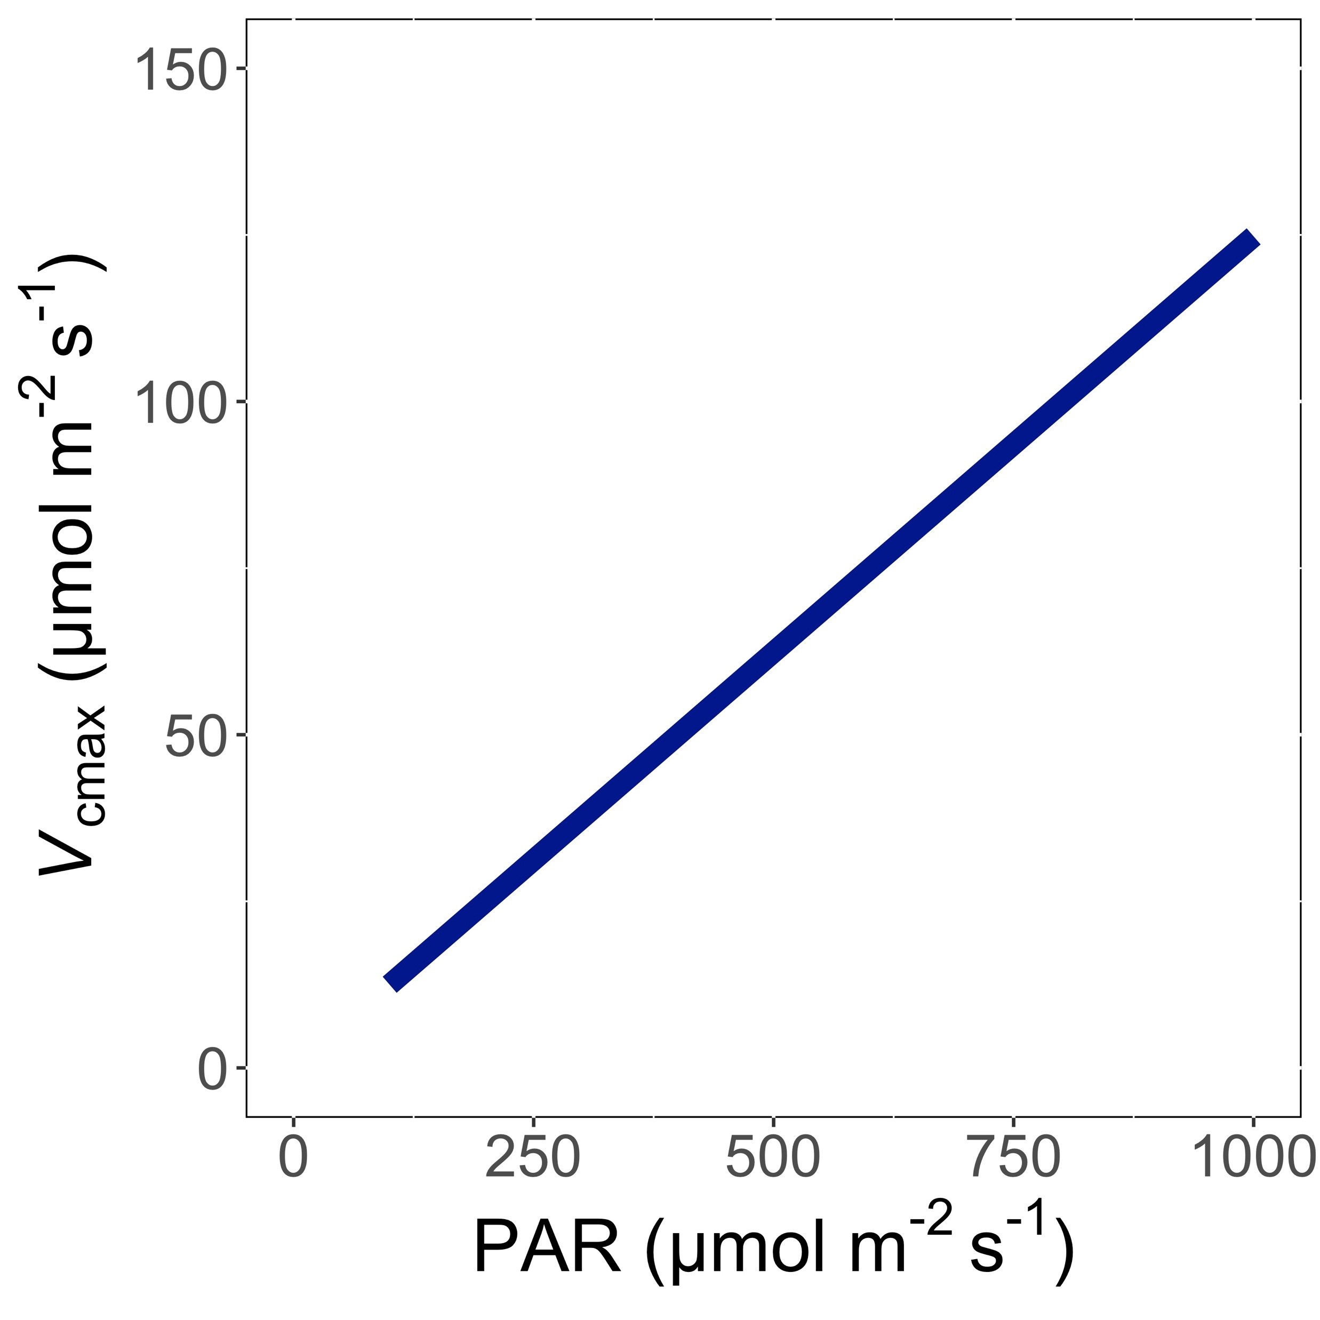
V_{cmax} increases with light because of greater electron transport
Smith et al. (2019) Ecol Letters; Smith and Keenan (2020) Glob Change Biology

Slide 31
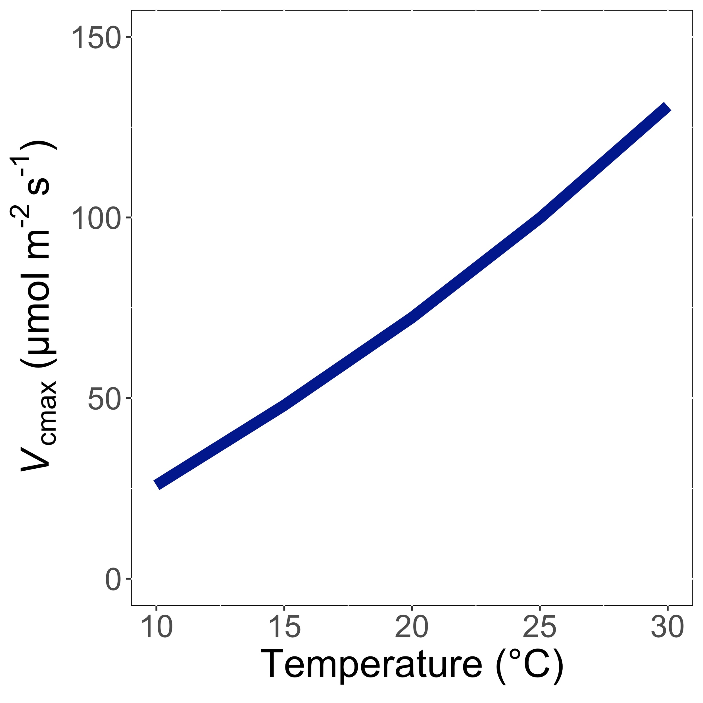
V_{cmax} increases with temperature because of greater electron transport and photorespiration
Smith et al. (2019) Ecol Letters; Smith and Keenan (2020) Glob Change Biology

Slide 32
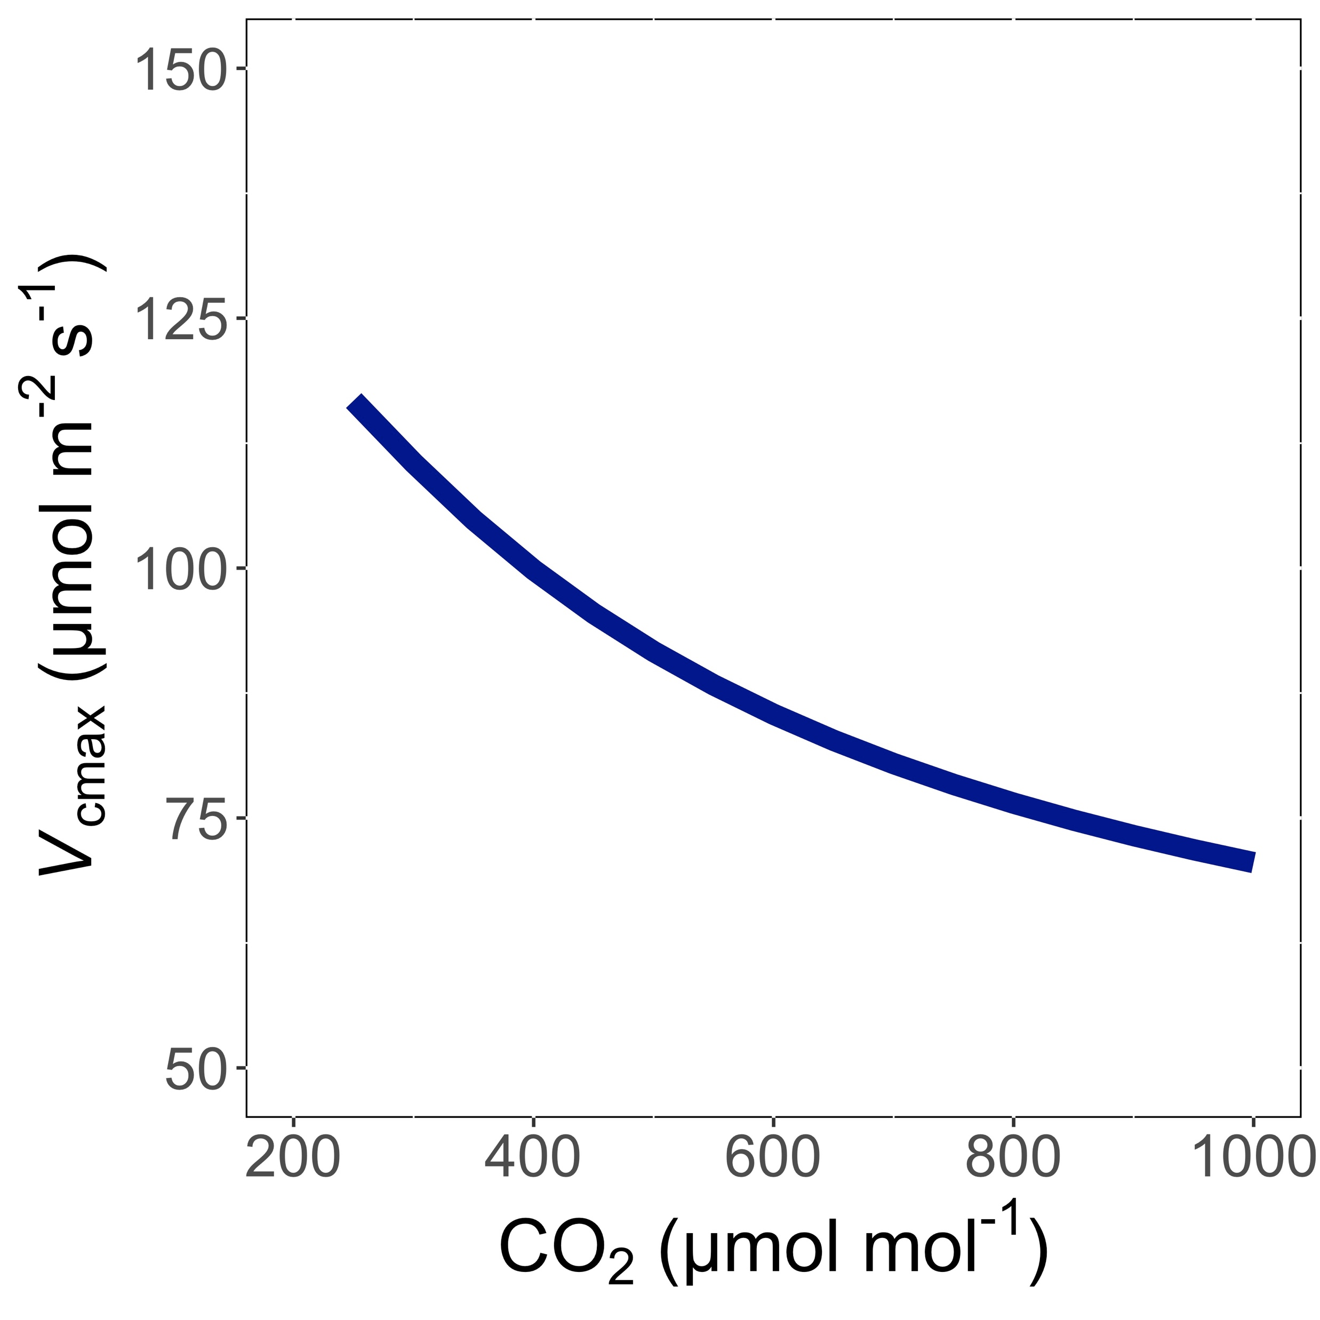
V_{cmax} decreases with CO₂ because of greater CO₂ in the leaf and less photorespiration
Smith et al. (2019) Ecol Letters; Smith and Keenan (2020) Glob Change Biology

Slide 33
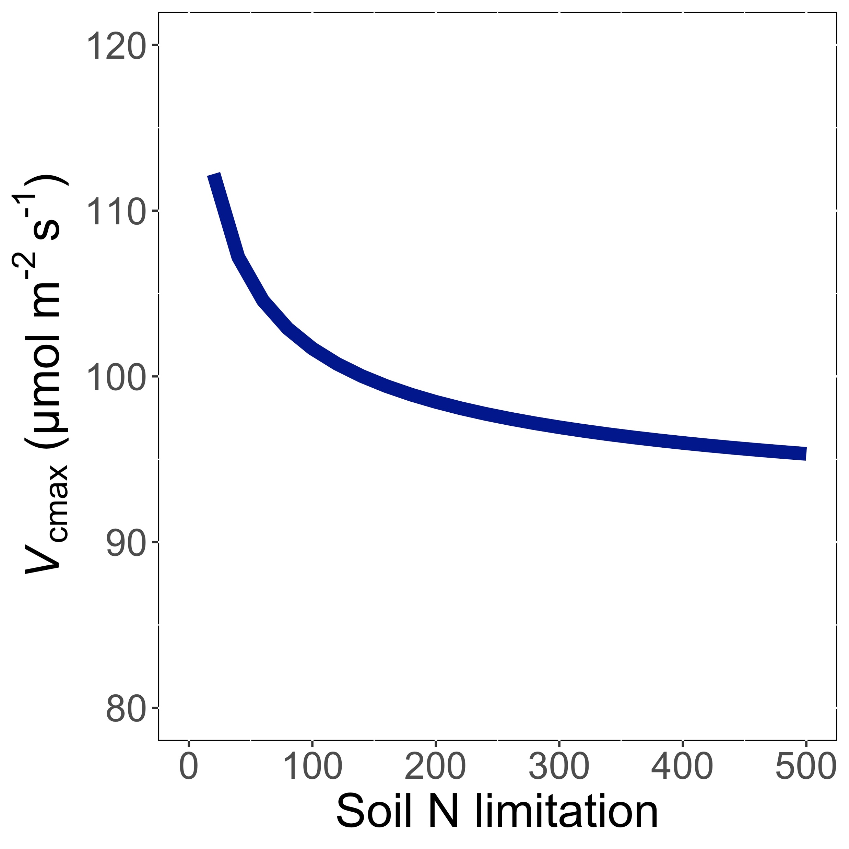
V_{cmax} decreases with soil N limitation because Rubisco requires a lot of N
Smith et al. (2019) Ecol Letters; Smith and Keenan (2020) Glob Change Biology

Slide 34
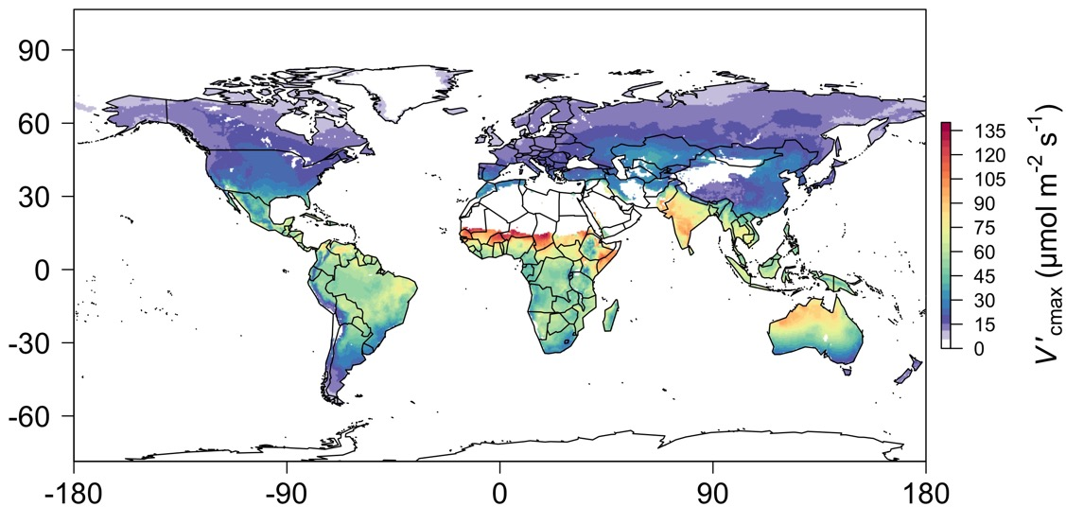
We can predict optimal traits in different environments
Smith et al. (2019) Ecol Letters

Slide 35
Ok great, but does it work?

Slide 36
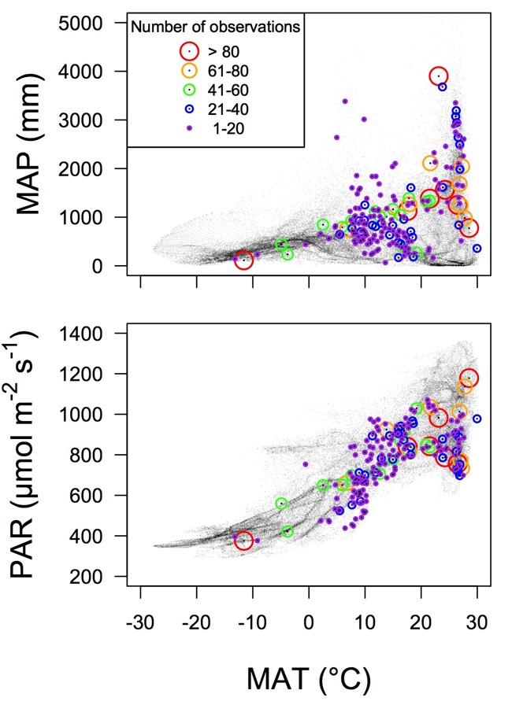
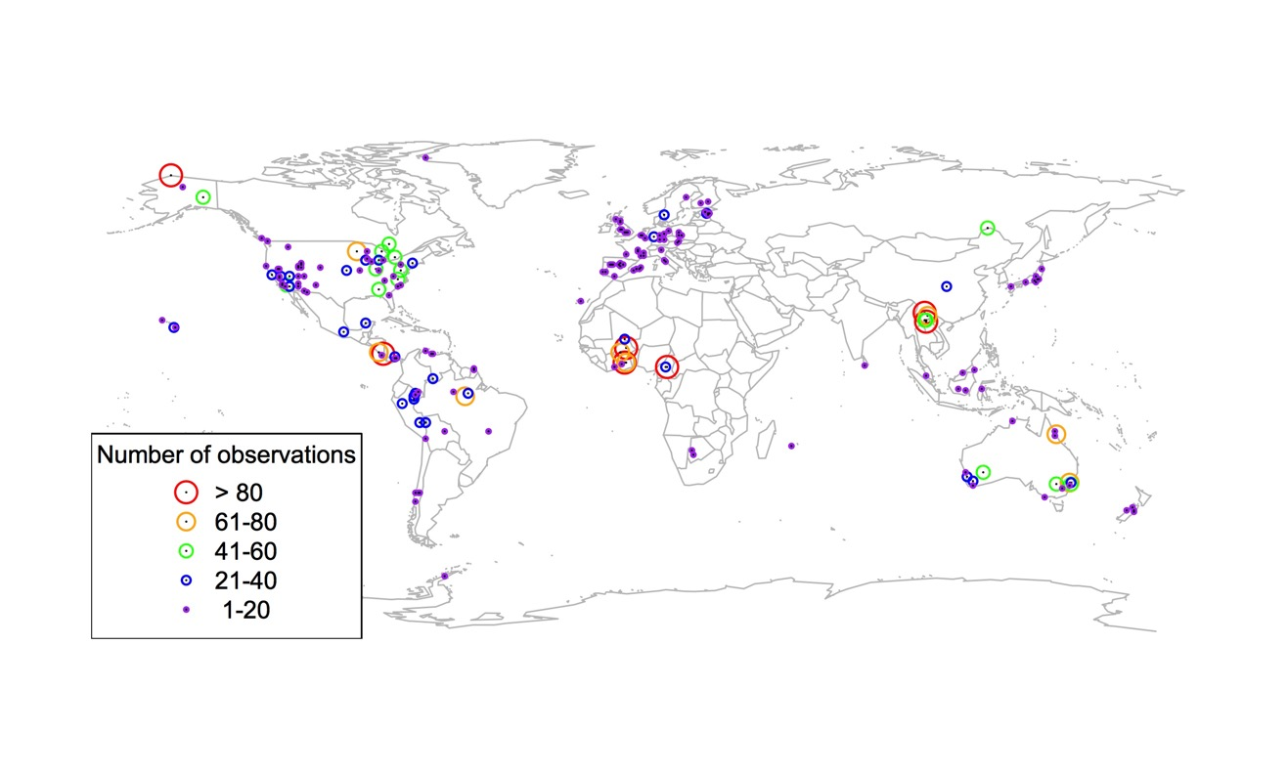
Global V_{cmax} dataset
3,697 measurements
202 sites
> 600 genera
Smith et al. (2019) Ecol Letters

Slide 37

Smith et al. (2019) Ecol Letters

Slide 38
Optimal V_{cmax} is similar to observed values
Smith et al. (2019) Ecol Letters

Slide 39
What does acclimation mean for future terrestrial biogeochemical cycling? An Example

Slide 40

Expected future responses
V_{cmax} decreases with CO₂ because of greater CO₂ in the leaf and less photorespiration
Smith et al. (2019) Ecol Letters

Slide 41
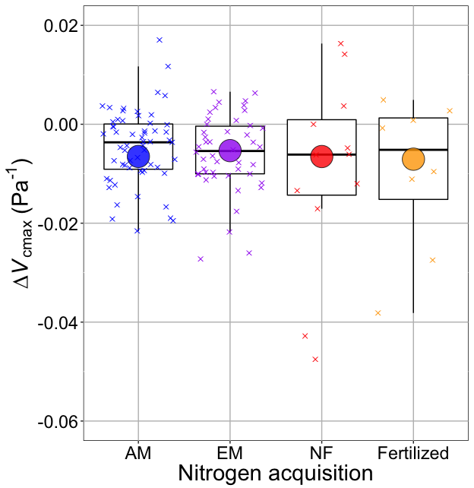
Smith and Keenan (2020) Glob Change Biol

Slide 42
V_{cmax} changes with CO₂ in ways expected from optimization
Boxes = data = -0.0063 Pa⁻¹
Circles = predicted = -0.0066 Pa⁻¹
Smith and Keenan (2020) Glob Change Biol

Slide 43
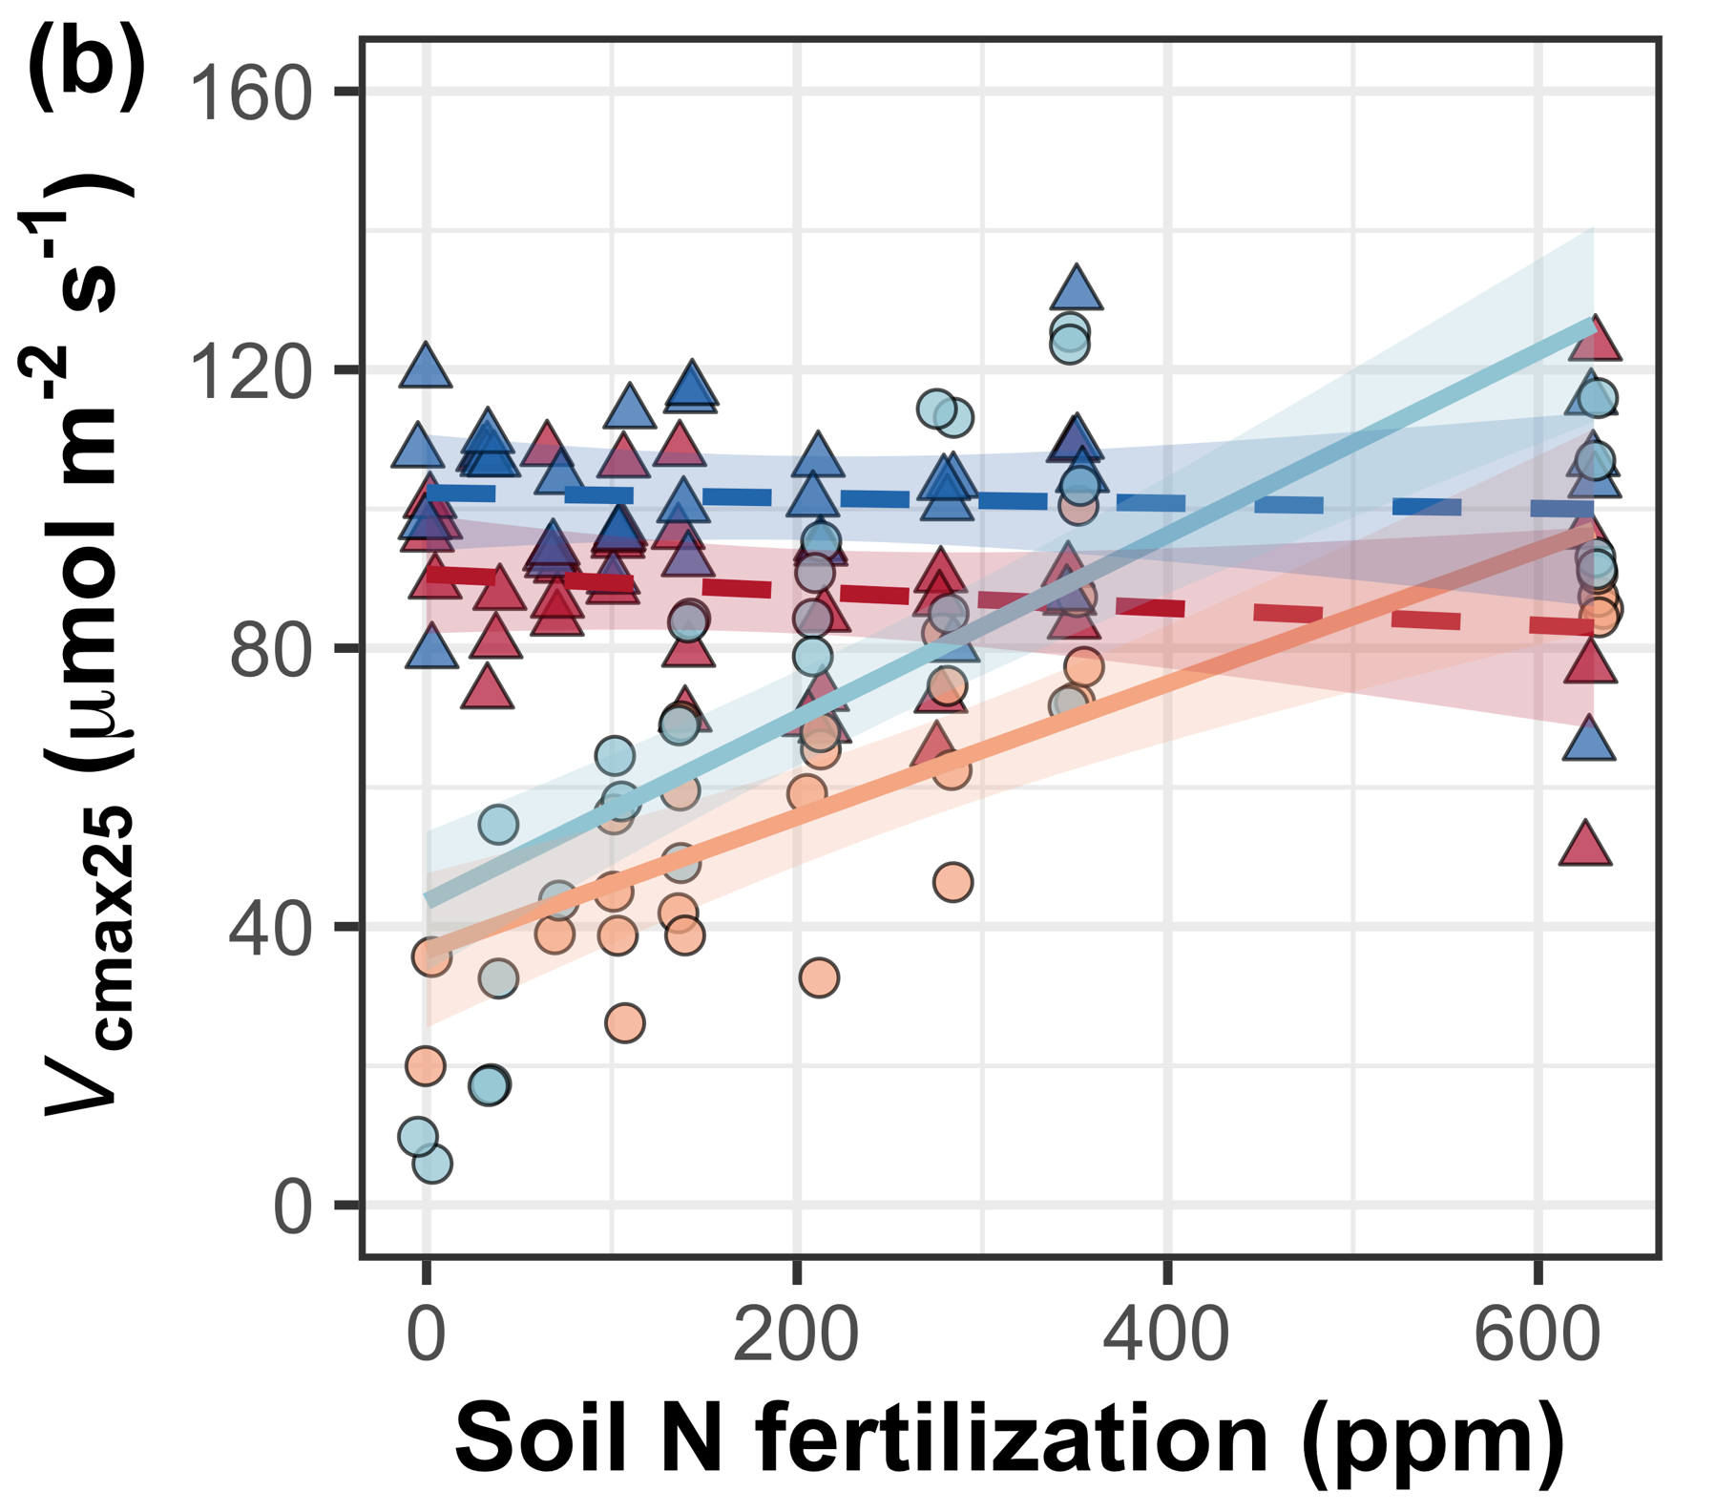
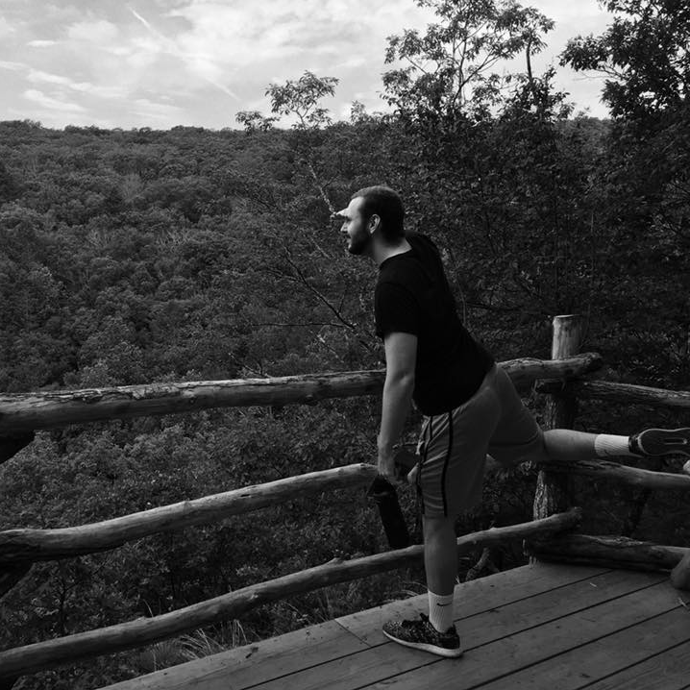
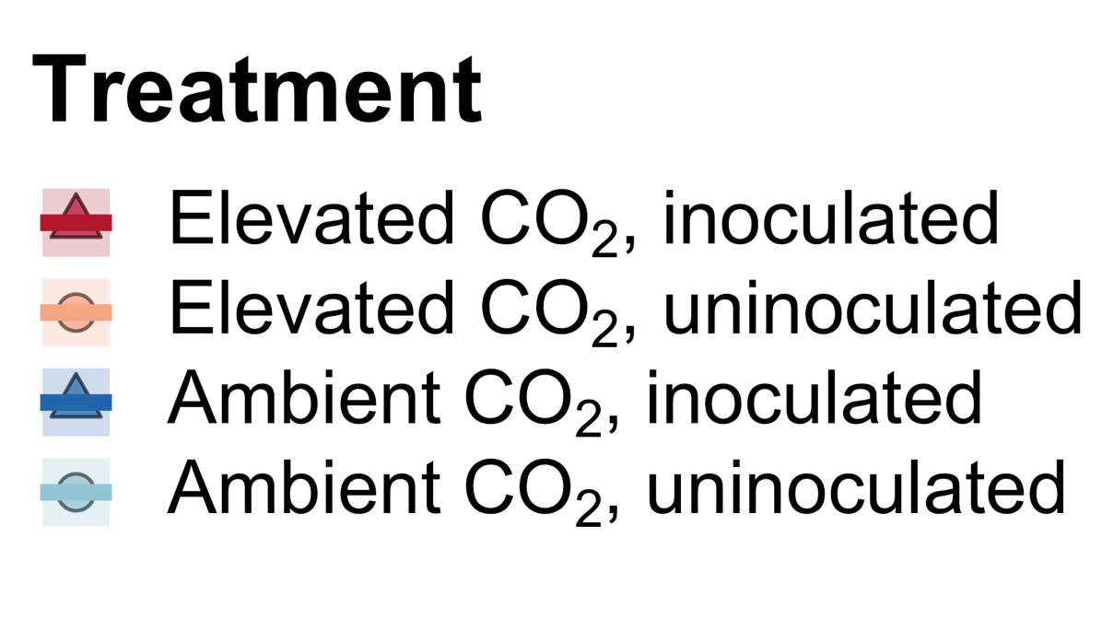

We further confirmed this universality of this response under 18 nitrogen by inoculation treatments
Perkowski, Ezekannagha, and Smith (2025) J Exp Botany

Slide 44
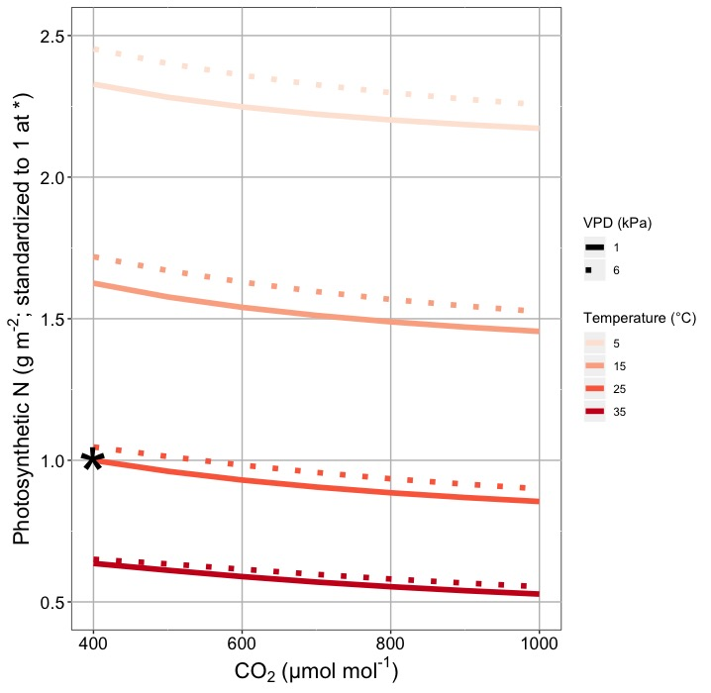
This generally suggests lower nitrogen demand under future conditions
Smith and Keenan (2020) Glob Change Biol

Slide 45

Let’s run a model out into the future!

Slide 46
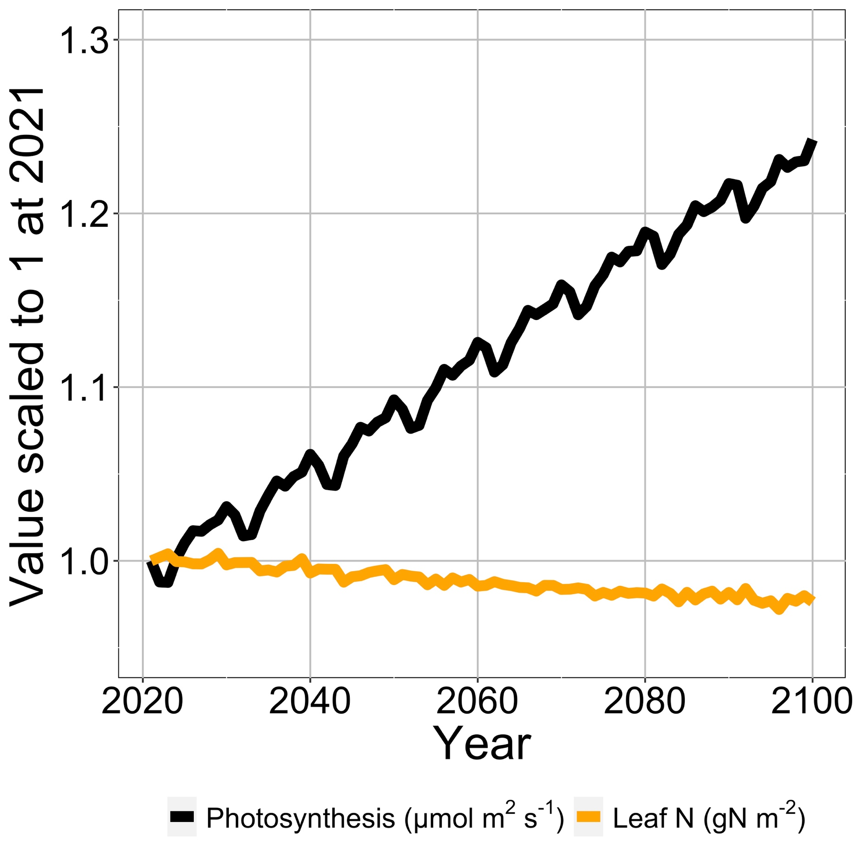
Photosynthesis increases with elevated CO₂ at lower leaf N
Smith et al. (2024) Glob Change Biol

Slide 47
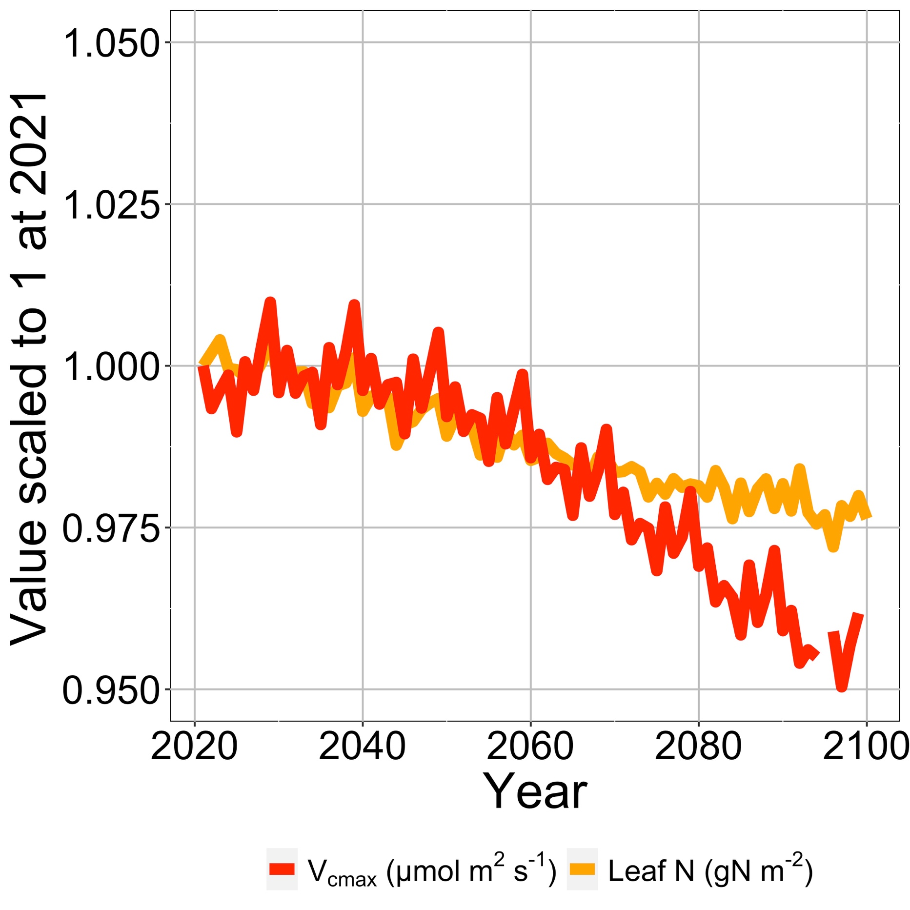
Leaf N reduction is due to a reduction in photosynthetic capacity
Smith et al. (2024) Glob Change Biol

Slide 48
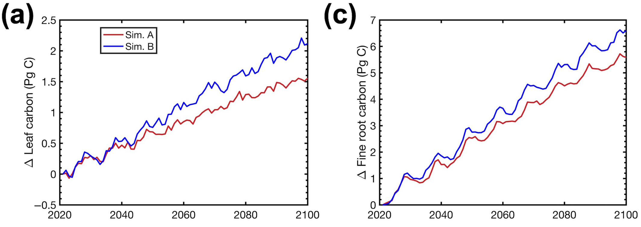
Plants build more leaves and fine roots
Smith et al. (2024) Glob Change Biol

Slide 49
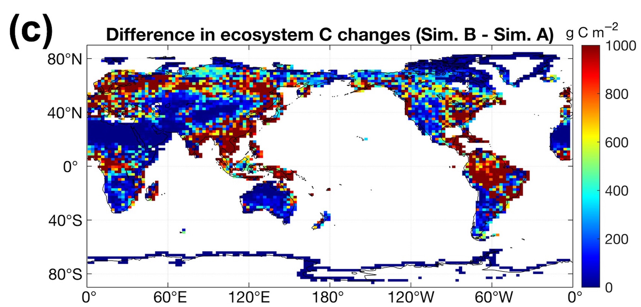
Leaf N savings increases long-term ecosystem carbon stocks
50% increase in ecosystem carbon from CO₂ acclimation
Smith et al. (2024) Glob Change Biol

Slide 50
Need to rethink nutrient limitation in models?
“No limitation” simulation
“Nutrient limitation” simulations
Weider et al. (2015) Nature Geosci

Slide 51
Extensions of this approach

Slide 52
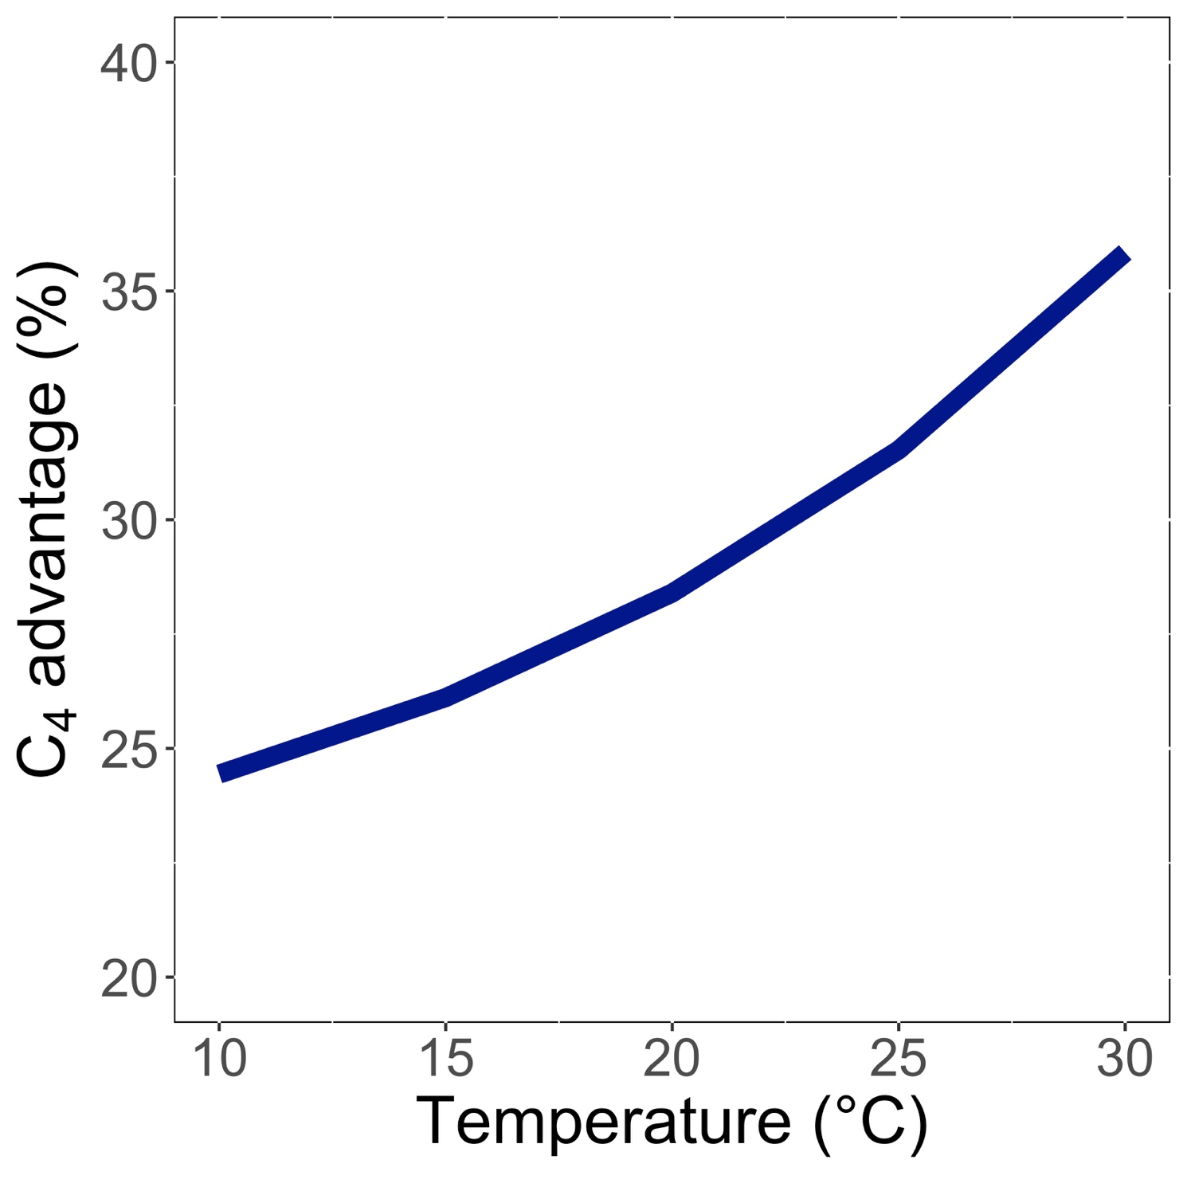
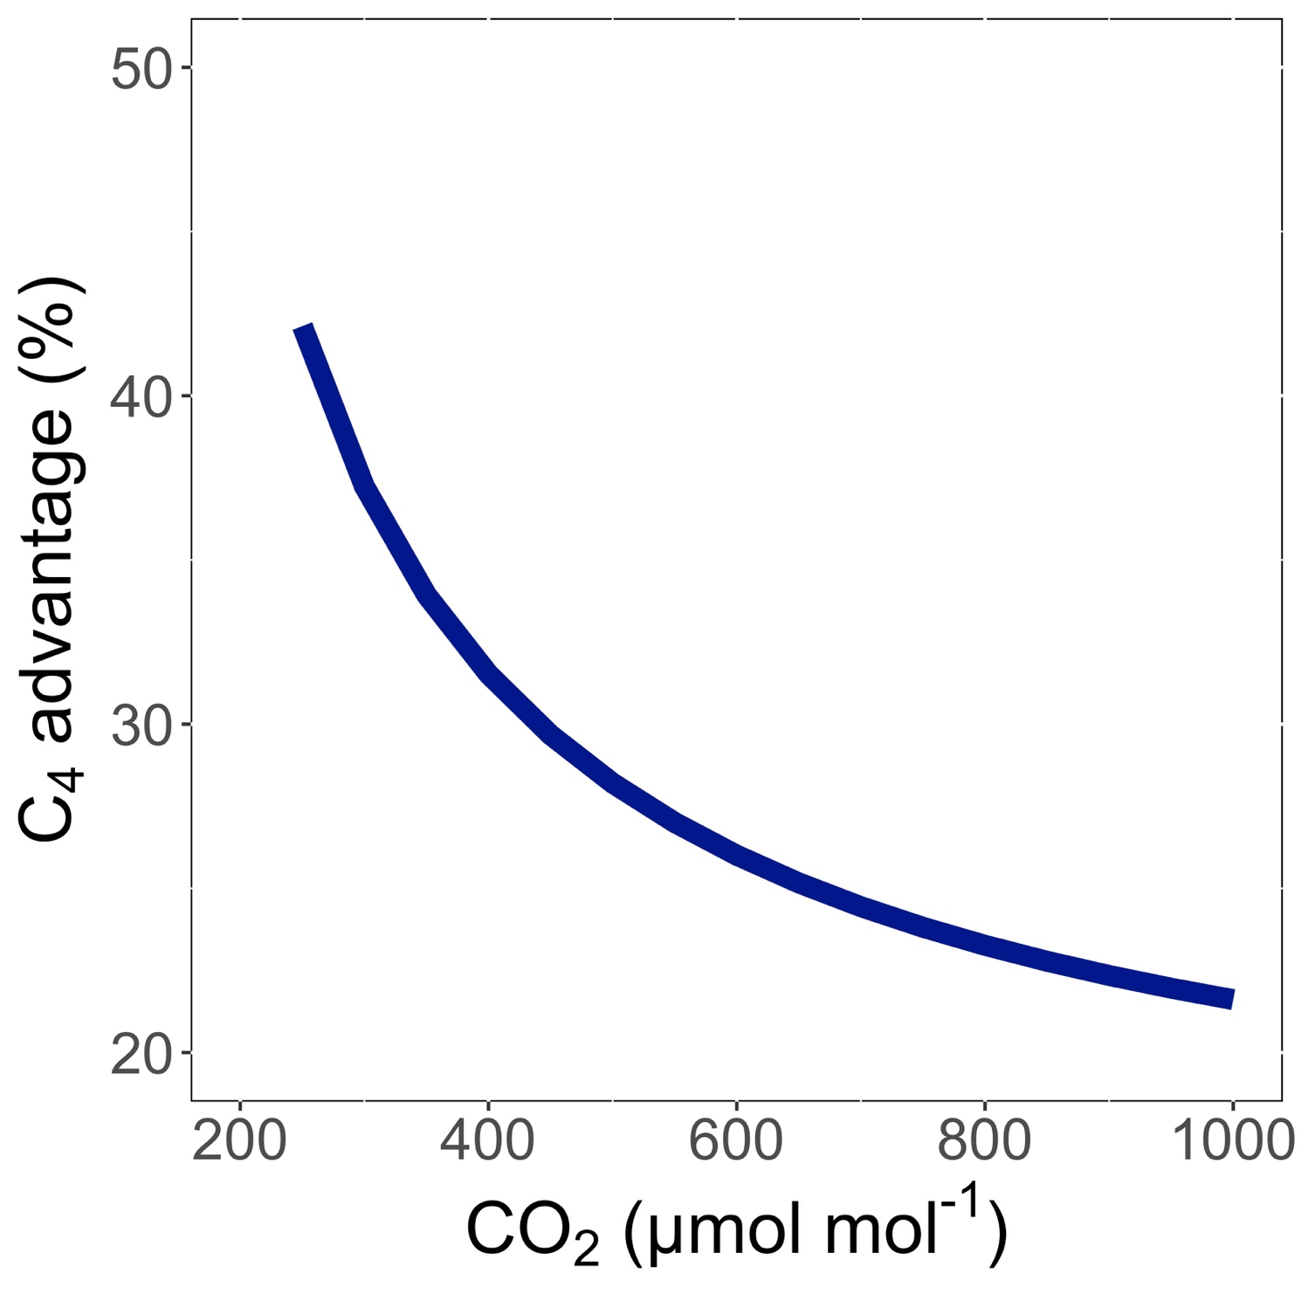
Extensions of this approach
C₄ photosynthesis
Scott and Smith (2022) JAMES

Slide 53
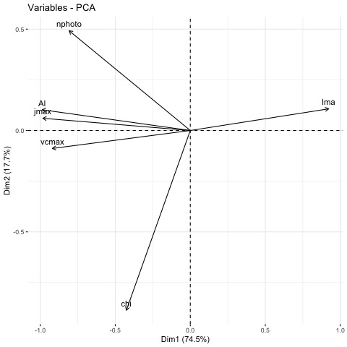
Extensions of this approach
Other leaf traits
Smith et al. (in prep)

Slide 54
Theory development can help with prediction, but is also a powerful tool to understand mechanism

Slide 55
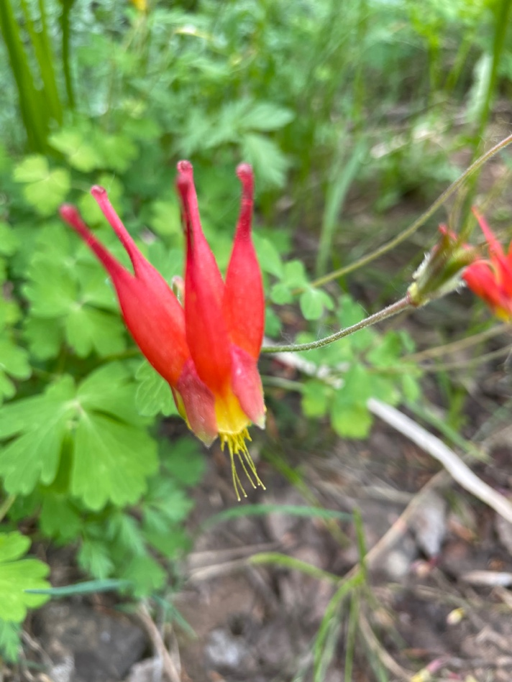
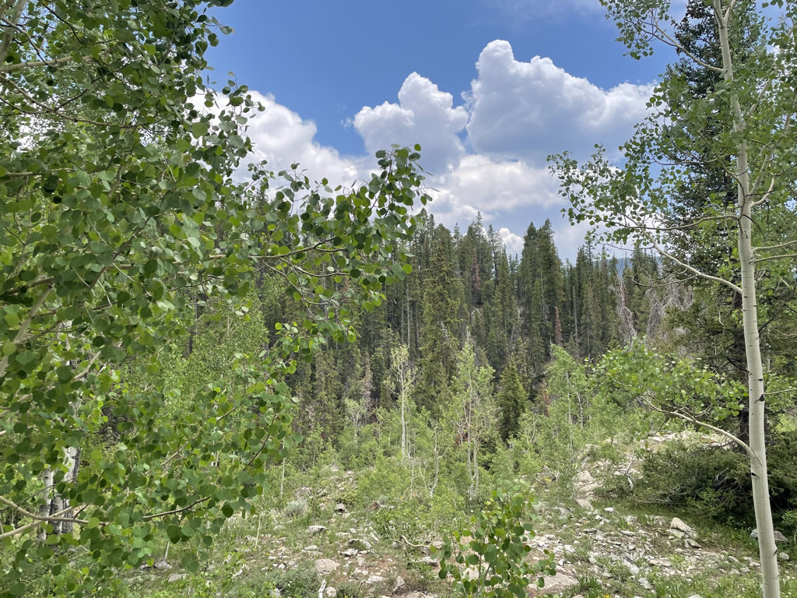
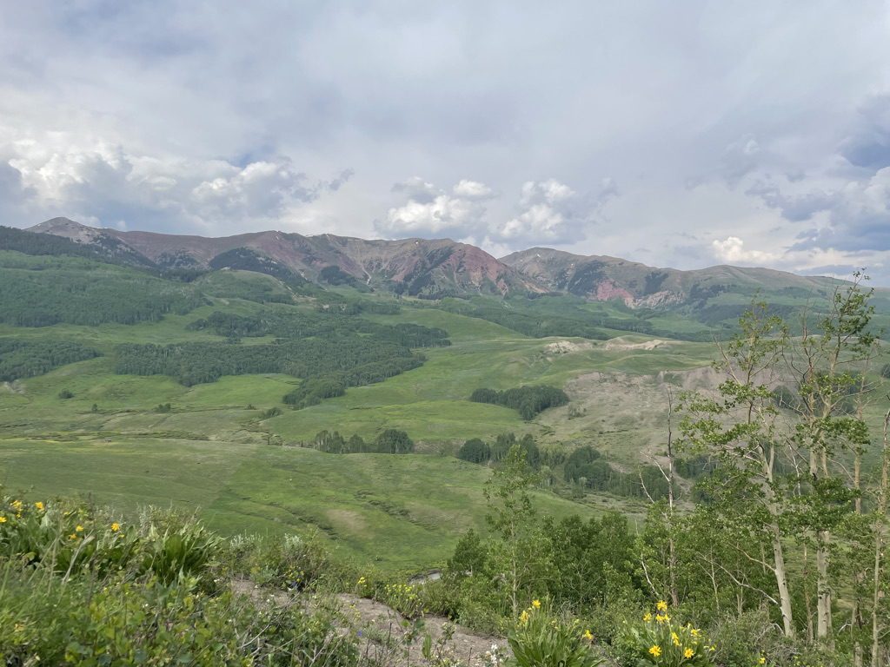
Acclimation theory has helped us understand…
Photosynthetic responses to nutrient availability (Waring et al., 2023; Stocker et al., 2025; Perkowski et al., 2025; Cheaib et al., 2025a)
Plant interactions with microbial symbionts (Perkowski et al., 2025; Cheaib et al., 2025b)
Photosynthetic trait influences on populations (Cheaib et al., in prep) and communities (Kelley et al., in prep)
f(x)
f(x)

Slide 56
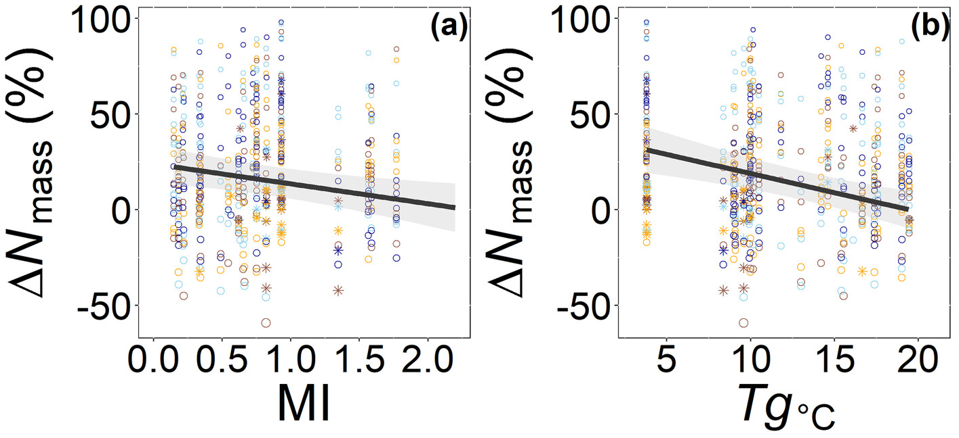
Acclimation theory has helped us understand…
Photosynthetic responses to nutrient availability (Waring et al., 2023; Stocker et al., 2025; Perkowski et al., 2025; Cheaib et al., 2025)
Leaves more responsive to soil N when demand is high (low MI, low T)
Cheaib et al. (2025) Ecol Letters

Slide 57
Acclimation theory has helped us understand…
Plant interactions with microbial symbionts (Perkowski et al., 2025; Cheaib et al., 2025)
Scavenging strategy (e.g., AMF) is less costly when soil N is high and mining strategy (e.g., EcMF) is less costly when soil N is low
Cheaib et al. (2025) New Phyt

Slide 58
Acclimation theory has helped us understand…
Photosynthetic trait influences on populations (Cheaib et al., in prep) and communities (Kelley et al., in prep)
As predicted from theory, increased leaf N confers greater species population growth in dry sites and this is enhanced by eutrophication.
Aridity
Cheaib et al. (in prep)

Slide 59
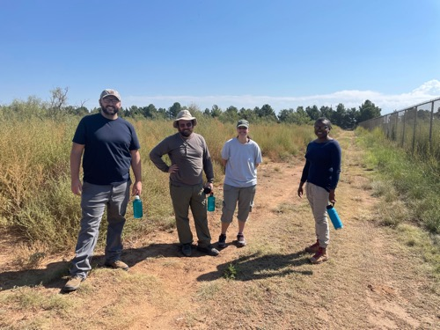
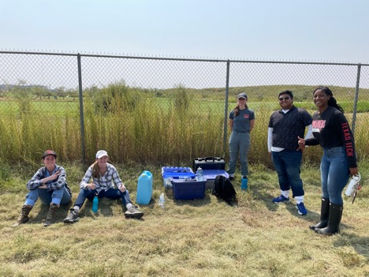
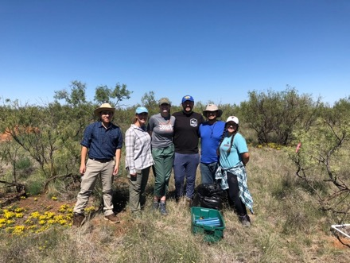
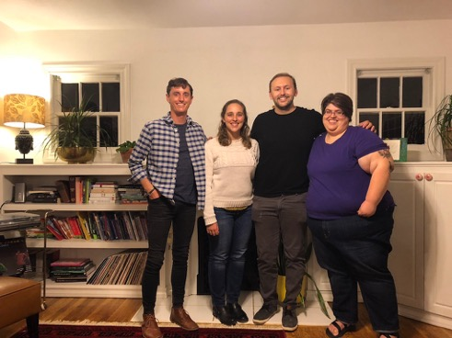






Acknowledgements
Current and former lab members
Alissar Cheaib (postdoc)
Evan Perkowski (postdoc)
Snehanjana Chatterjee (PhD)
Monika Kelley (PhD)
Isabella Beltran (PhD)
Daniel Owusu Kwakye (PhD)
Garrison Garza (PhD)
Clara Drake (MS)
Gwen Wattt (MS)
Brad Posch (postdoc)
Jeff Chieppa (postdoc)
Lizz Waring (postdoc)
Kieran Carroll (lab manager)
Christine Vanginault (MS)
Zinny Ezekannagha (MS)
Eve Gray (MS)
Risa McNellis (MS)
Helen Scott (MS)
Too many (40+) undergrads to list!
Collaborators around the world
Funding
GRC
NSF
USDA
NPS
USGS
Schmidt Futures
Texas EcoLab

Slide 60
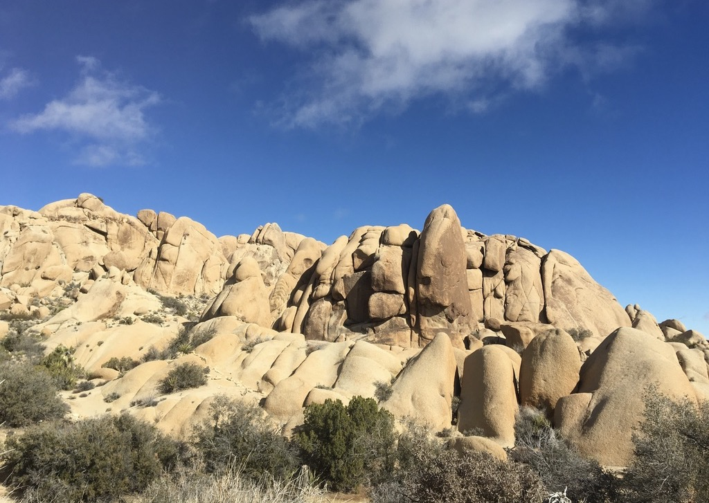
Presentation available at:
www.github.com/SmithEcophysLab/seminar/2025_grc
Model code:
www.github.com/SmithEcophysLab/optimal_vcmax_R
Contact: nick.smith@ttu.edu
Thanks!

